Slide 1

Login And Registration Page
A Internship Project on
Represented By,
Swapnil Jadhav

Slide 2
INTRODUCTION
Login and registration is a critical component of any web application. This presentation will cover the basics of implementing a login and registration system using JSP, Servlet, JDBC, and MySQL.
We will discuss the design, development, and deployment of the system, as well as the advantages and disadvantages of using this technology stack.

Slide 3
DESIGN
The design of the login and registration system is critical for a successful implementation. The system should be secure and easy to use for both the user and the developer.
The system should also be able to handle different types of users, such as administrators and regular users. The design should also take into account any scalability requirements.

Slide 4
DEVELOPMENT
The development of the login and registration system should be done using JSP, Servlet, JDBC, and MySQL. This technology stack is well-suited for web applications and is easy to use.
The development process should include the creation of the database, the implementation of the user authentication, and the development of the user interface.

Slide 5
DEPLOYMENT
The deployment of the login and registration system should be done on a web server. The web server should be configured to run the application, and the database should be properly setup.
The deployment process should also include the testing of the system to ensure that it is working correctly and that the security features are working properly.

Slide 6
ADVANTAGES
The use of JSP, Servlet, JDBC, and MySQL for the login and registration system has several advantages. It is easy to use, secure, and can be easily scaled.
The technology stack is also well-suited for web applications and is widely used by developers, which makes it easy to find help and support.

Slide 7
CONCLUSION
The project also provides a secure way to authenticate the user with the stored credentials. It uses a combination of encryption and hashing algorithms to ensure the security of the user's credentials. The project also provides a user-friendly interface to allow users to easily register and login to the website.
Login with registration page using JSP, Servlet, JDBC, and MySQL is a project that provides a secure and efficient way to authenticate users on a website. It uses JSP, Servlet, JDBC, and MySQL to create a secure and efficient login page with registration page. The project also provides a secure way to store the user's credentials in the database.

Slide 8
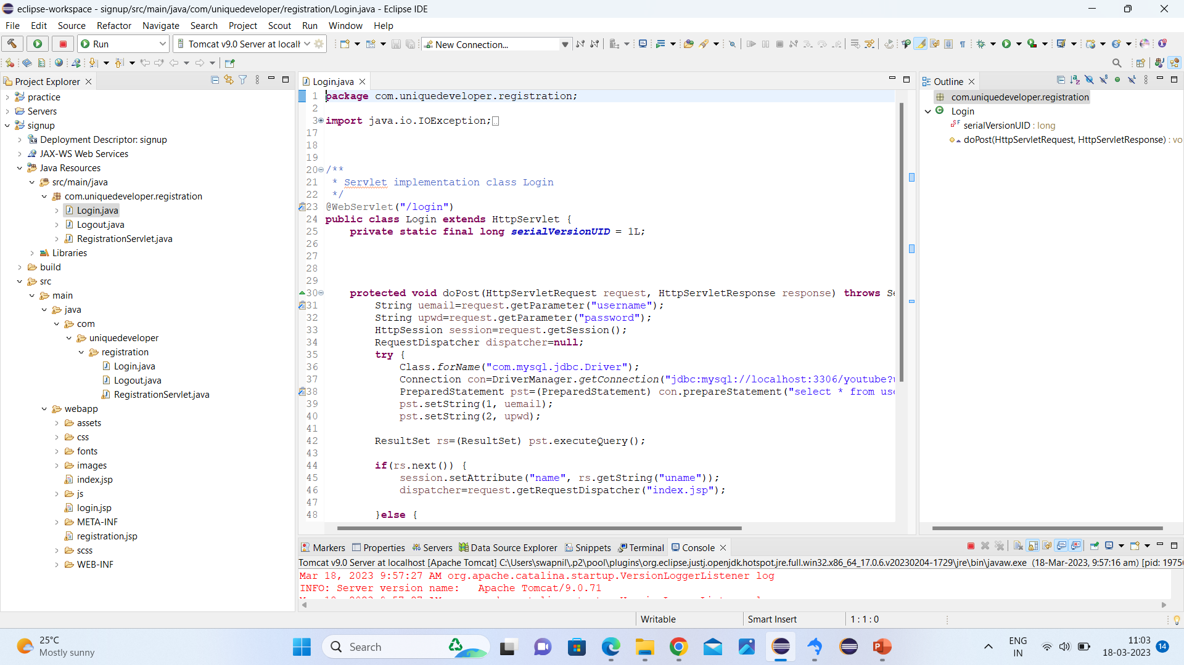
Login.java Code

Slide 9
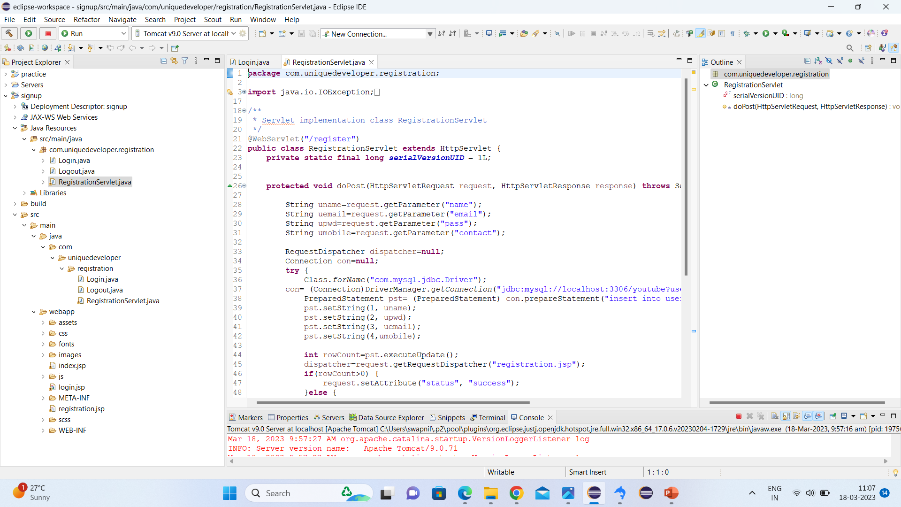
RegistrationServlet.java

Slide 10
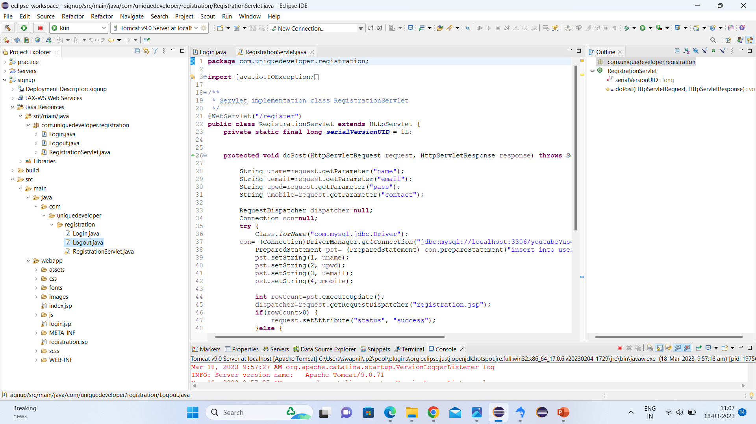
Logout.java

Slide 11
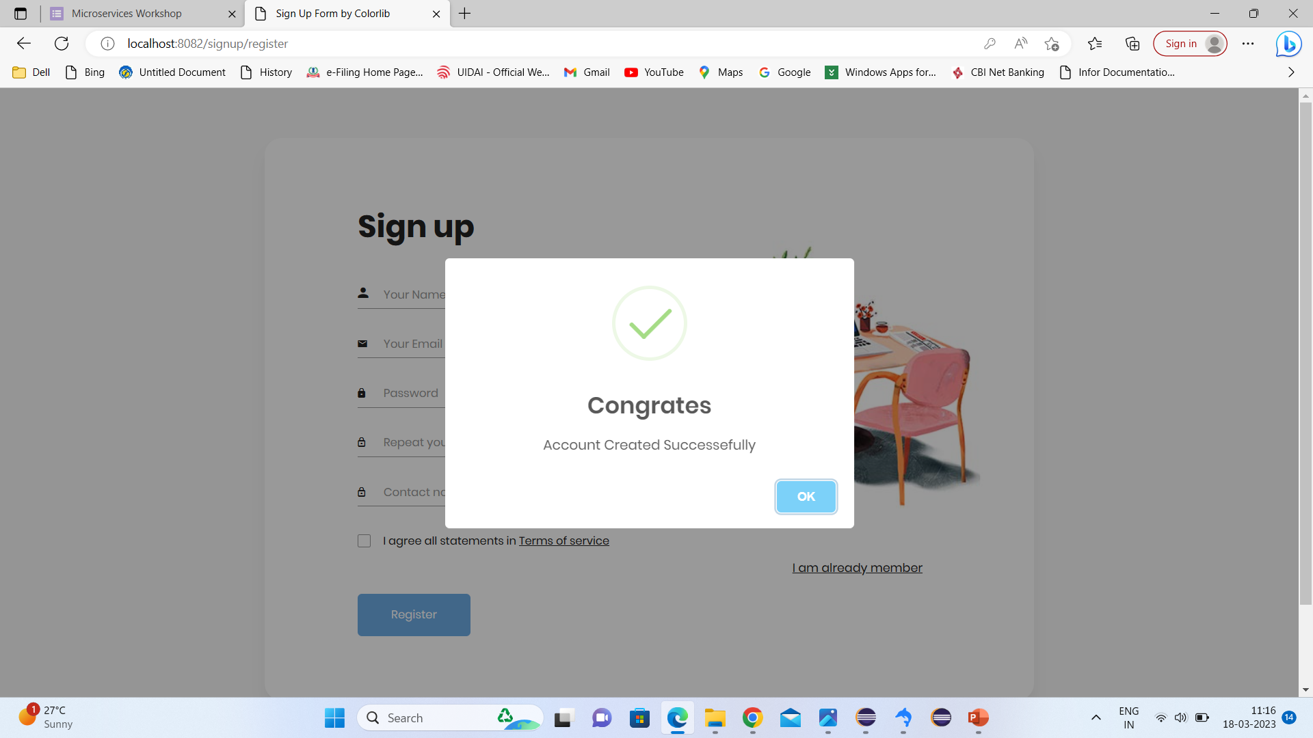
Sign In Form

Slide 12
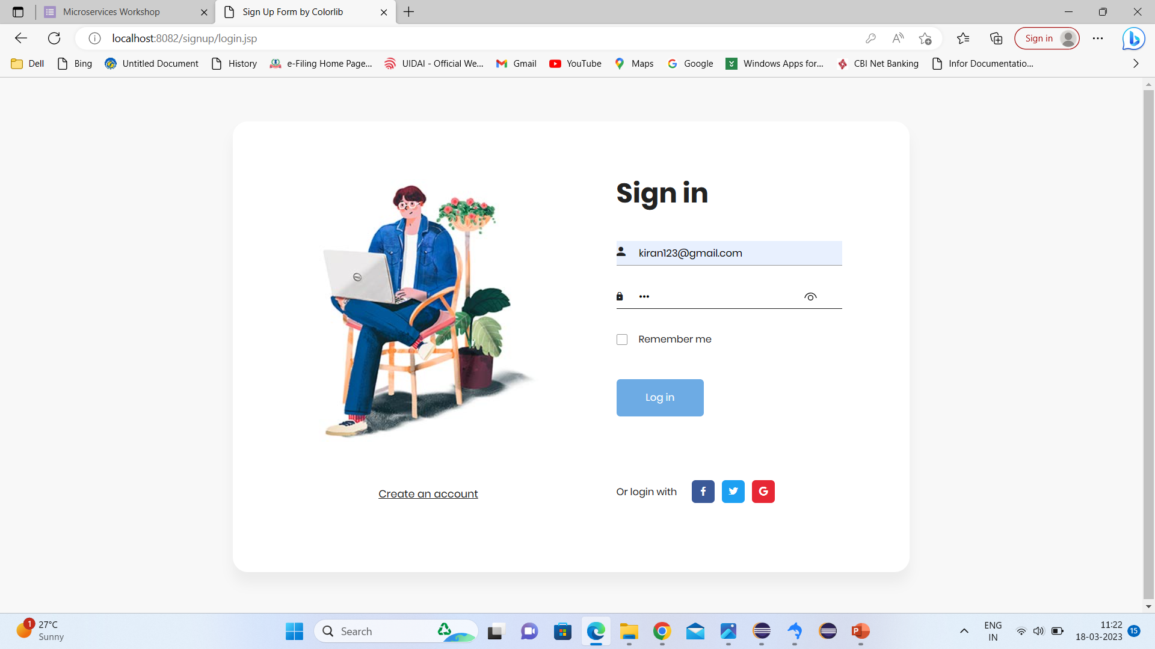
Sign Up Form

Slide 13

Login Page

Slide 14
THANK YOU…..

